Slide 1

Company Reputation Analysis using Twitter Sentiment Analysis
GROUP 7
GANDHAM SAI KUMAR
GREESHMA REDDY MANDA
ALLA SAI ADITHYA REDDY

Slide 2

TABLE OF CONTENTS
INTRODUCTION
PROJECT OBJECTIVES
TWITTER SENTIMENT ANALYSIS
DATA SOURCES AND COLLECTION
TOOLS AND TECHNOLOGIES
DATA EXPLORATION
INSIGHTS
RECOMMENDATIONS
FUTURE OPPORTUNITIES
CHALLENGES
CONCLUSION
REFERENCES

Slide 3

INTRODUCTION
This project aims to analyze the reputation of companies by using Twitter sentiment analysis. With the increasing importance of social media in shaping public opinion, it has become crucial for companies to monitor and manage their online reputation. By analyzing the sentiment of tweets related to specific companies, we can gain insights into how the public perceives them and identify areas of improvement. This project is highly relevant to the course as it combines techniques from natural language processing and machine learning to analyze large volumes of text data and extract meaningful insights.
Notes:
In today's digital age, social media platforms play a pivotal role in shaping the reputation of companies. Twitter, being one of the most influential social media platforms, serves as a rich source of real-time data and public opinions. Analyzing sentiment on Twitter provides valuable insights into how a company is perceived by its stakeholders, customers, and the general public.The primary objective of a Company Reputation Analysis using Twitter Sentiment Analysis is to gauge the sentiment surrounding a company, its products, and services. By systematically analyzing tweets, businesses can gain a deeper understanding of public perception, identify areas of improvement, and proactively address issues to enhance overall reputation.

Slide 4

PROJECT OBJECTIVES
The project aims to analyze the reputation of companies using Twitter sentiment analysis. By leveraging big data platforms, the project seeks to address the following specific problems and questions:
How do customers perceive different companies on Twitter?
What are the common sentiments expressed towards specific companies?
Are there any patterns or trends in customer sentiment towards companies over time?
Can sentiment analysis on Twitter be used to predict the reputation of companies?

Slide 5

TWITTER SENTIMENT ANALYSIS
Twitter sentiment analysis is the process of using natural language processing and machine learning techniques to analyze the sentiment of tweets.
It involves categorizing tweets as positive, negative, or neutral based on the sentiment expressed in the text.
Sentiment analysis can be used to understand public opinion towards a company or brand, identify customer sentiment, and monitor online reputation.

Slide 6
DATA SOURCES AND COLLECTION
Twitter Dataset from Kaggle
1.2 Gb
Challenges in Data Collection :
Volume: Collecting and processing large amounts of Twitter data requires efficient infrastructure and storage.
Data Quality: Filtering out spam, irrelevant, or biased tweets to ensure accurate sentiment analysis.
Language Processing: Handling multilingual tweets and understanding contextual nuances.

Slide 7

TOOLS AND TECHNOLOGIES
Big Data Platforms
Apache Hadoop: This distributed processing framework allowed us to store and process massive amounts of data across a cluster of computers.
Apache Spark: With its lightning-fast processing capabilities, Spark enabled us to perform real-time analytics on the Twitter data and extract valuable insights.
Tools
Python: We used Python as our primary programming language for data preprocess sing, sentiment analysis, and data visualization.
Textblob :Text Blob is a Python (2 and 3) library for processing textual data. It provides a simple API for diving into common natural language processing (NLP) tasks such as part-of-speech tagging, noun phrase extraction, sentiment analysis, classification, translation, and more.
Matplotlib : These data visualization libraries allowed us to create insightful charts and graphs to present our findings.

Slide 8
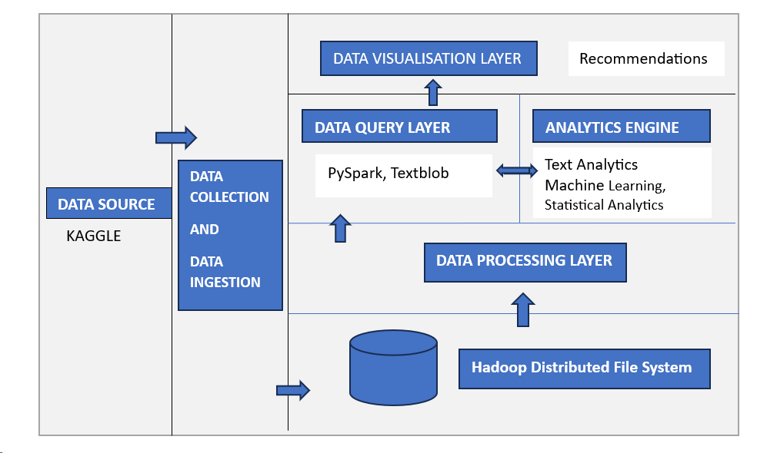
DATA STACK DIAGRAM

Slide 9
REPORTS
In our reputation analysis of companies using Twitter sentiment analysis, we generated several reports to provide insights and recommendations for better ROI
Overall Sentiment Analysis
Competitor Comparison
Key Influencers
Trending Topics

Slide 10
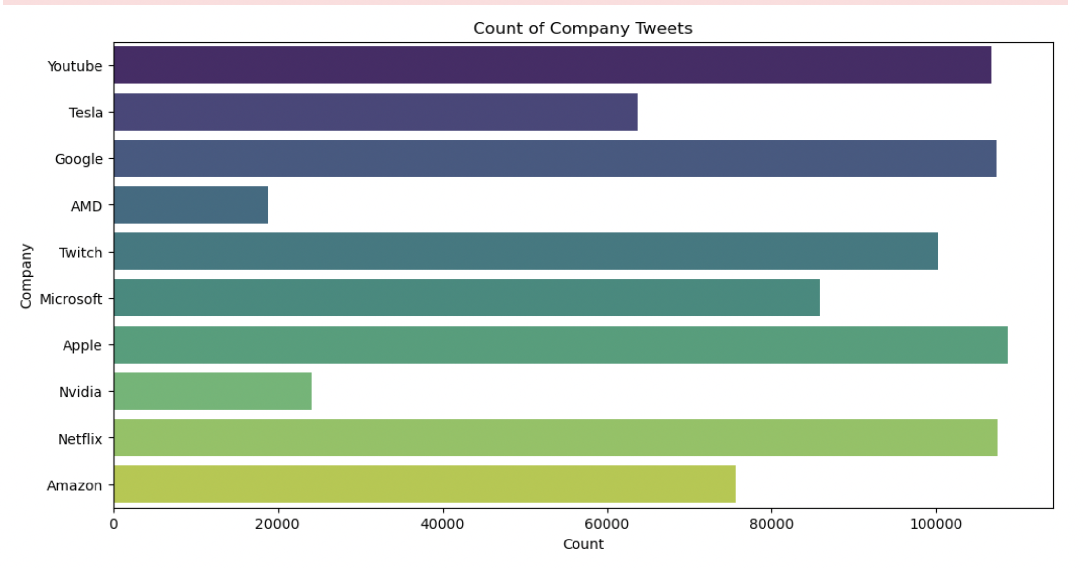
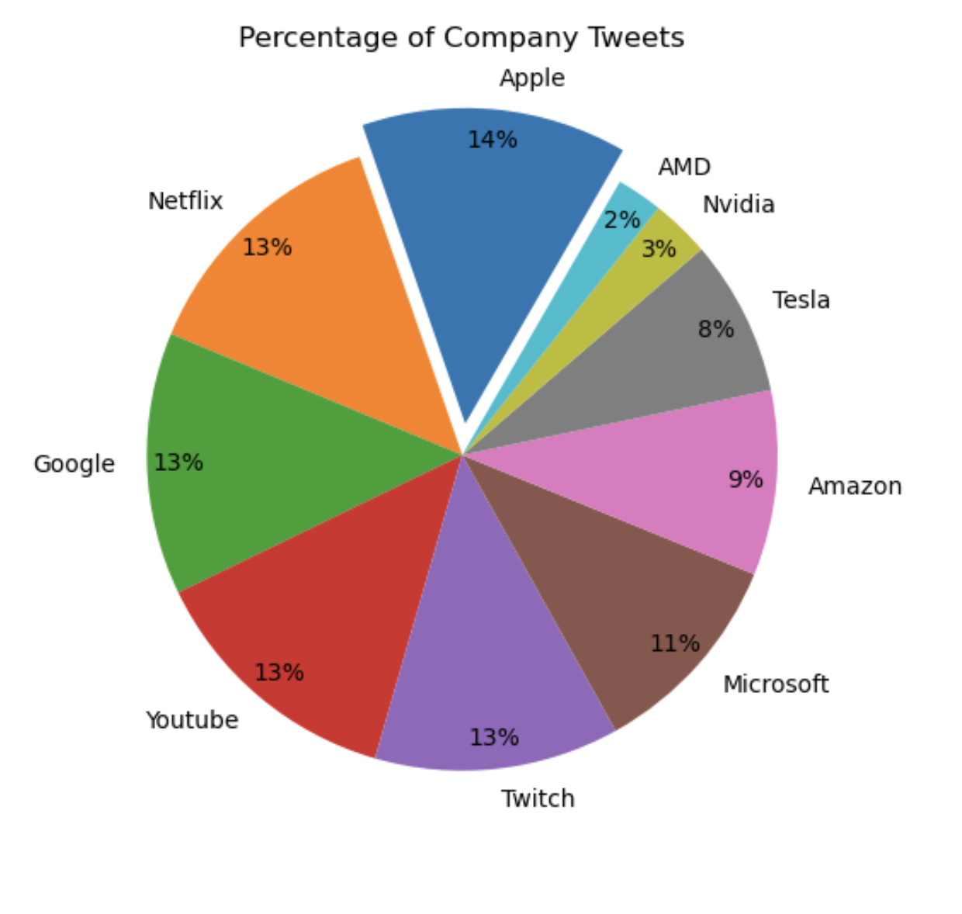
DATA EXPLORATION

Slide 11
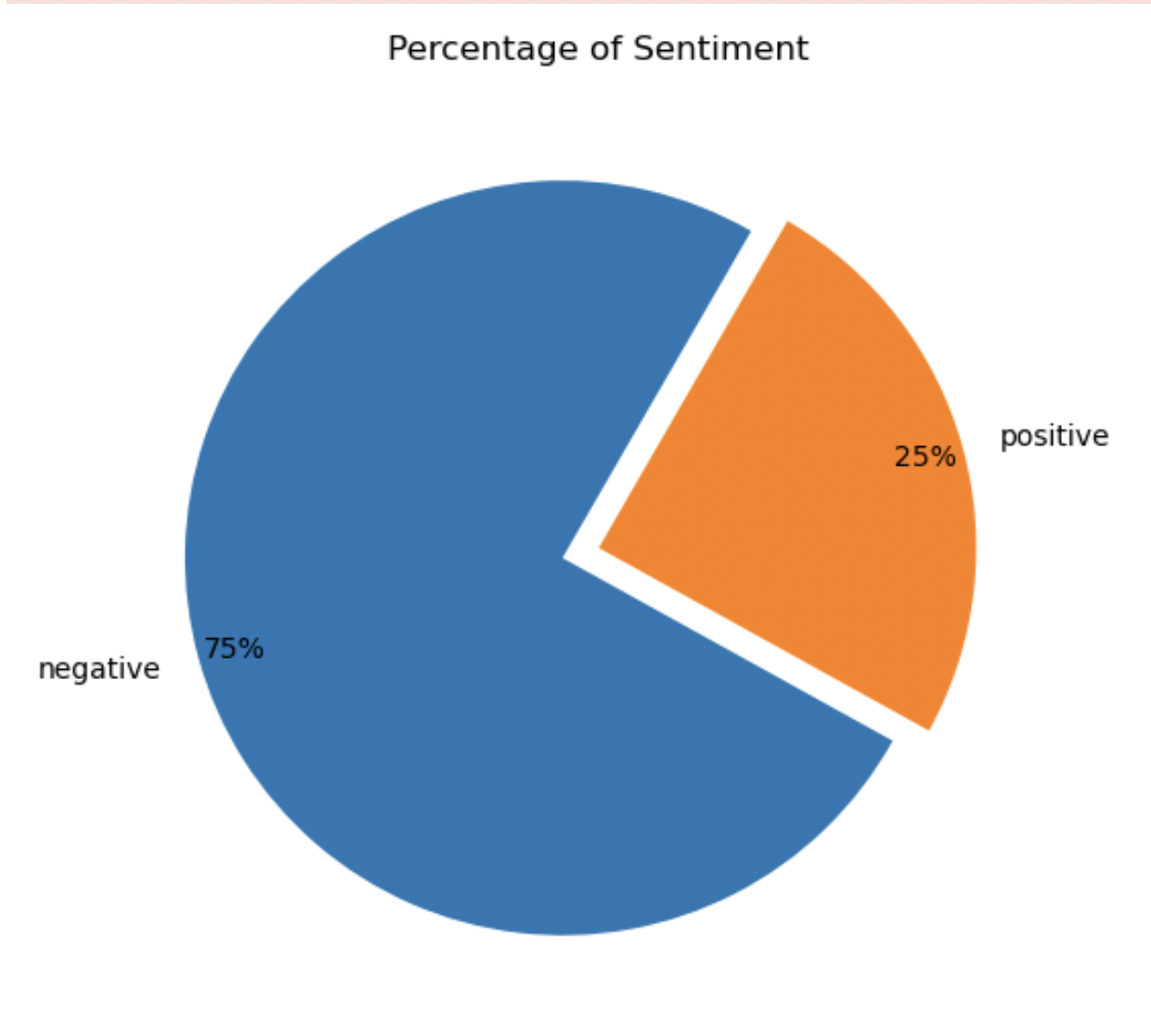
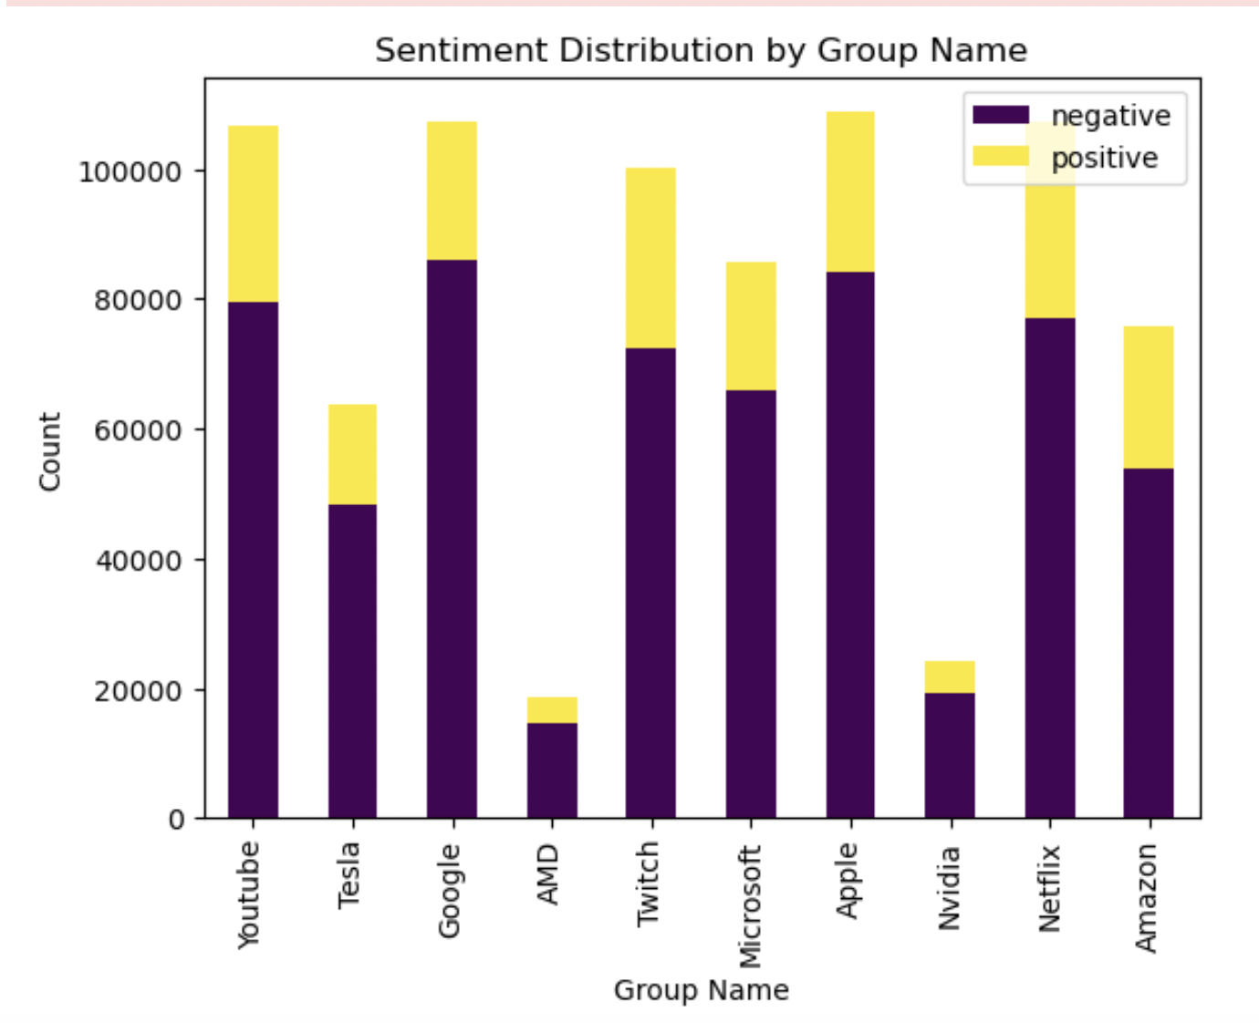

Slide 12
Insights
Monitoring Brand Perception
Active social listening helps you take the pulse on how people perceive your brand. You can identify rising complaints, viral negative content and shifts in brand image that require PR response.
Understanding Customers
People turn to Twitter to voice complaints, ask questions and seek support. Analyzing these conversations enables you to truly understand pain points and delight points in the customer experience.

Slide 13
Recommendations
Based on the findings, stakeholders can make informed decisions about corporate reputation management, brand strategies, and customer engagement approaches. The insights derived from this sentiment analysis project can be valuable for addressing public perceptions and adapting business strategies accordingly.
Invest in proactive customer service measures to address issues promptly and minimize negative sentiment.
Collaborate with influencer to leverage their positive sentiment and reach a wider audience.
Develop marketing campaigns highlighting the company's sustainability efforts to align with the trending topic and appeal to environmentally-conscious consumers.
Conduct a thorough analysis of competitor brand perception strategies to identify areas for improvement and enhance the company's brand image.

Slide 14

Future Opportunities
Brand Innovation:
Analyzing sentiments around new products or features can guide innovation, ensuring that the company stays ahead in terms of customer satisfaction and market trends.
Real-Time Marketing Optimization:
Quickly adapt marketing campaigns based on real-time sentiment data, optimizing messaging for better resonance with the target audience.
Integration with Voice of Customer (VoC):
Integrate Twitter sentiment analysis with other VoC channels to create a comprehensive understanding of customer opinions across various touchpoints.
Global Market Insights:
Gain insights into regional and cultural sentiment variations, enabling companies to tailor their strategies for different market

Slide 15

CHALLENGES
Fake News and Misinformation:
Filtering out fake news and misinformation on social media platforms is a growing challenge that may impact the accuracy of sentiment analysis.
Managing Overwhelming Data Volume:
The sheer volume of data generated on social media requires efficient tools and technologies to manage, process, and derive meaningful insights.
Interpreting Complex Emotions:
Understanding and accurately interpreting complex emotions, sarcasm, and context in social media posts poses a challenge for sentiment analysis models.

Slide 16
CONCLUSION
In conclusion, employing Twitter sentiment analysis for reputation analysis in big tech companies provides invaluable insights into public perception. This approach not only enables proactive crisis management but also facilitates data-driven decision-making for strategic initiatives. As technology evolves, continuous adaptation of sentiment analysis models is crucial to navigate emerging challenges and seize opportunities, ultimately enhancing the overall brand image and competitive advantage.

Slide 17
REFERENCE:
Almonajed, Obada & Jukic, Samed. (2021). Sentiment Analysis on Twitter Data using Big Data. Journal of Engineering and Natural Sciences. 3. 10.14706/JONSAE2021311.
H. Vanam and J. R. R. R, "Sentiment Analysis of Twitter Data Using Big Data Analytics and Deep Learning Model," 2023 International Conference on Artificial Intelligence and Knowledge Discovery in Concurrent Engineering (ICECONF), Chennai, India, 2023, pp. 1-6, doi: 10.1109/ICECONF57129.2023.10084281.

